Slide 1
HIRING PROCESS ANALYTICS
Project Description:
Approach:
Hiring process is the fundamental and the most important function of a company. Here, the MNCs get to know about the major underlying trends about the hiring process. Trends such as- number of rejections, number of interviews, types of jobs, vacancies etc. are important for a company to analyze before hiring freshers or any other individual.
Requirement:
We are going to Clean the data, by Exploratory Data Analysis and then create charts and graphs to meet the business requirement.
We are going to find some Insights such as “HIRING”, “AVERAGE SALARY”, “CLASS INTERVAL”, and create different kinds of “CHART/PLOTS” to find some major insights that can help the company grow.
Tech –Stack used
Excel(MS Office Home & Student 2019

Slide 2
EXPLORATORY DATA ANALYSIS
1. Understanding Data Columns & Data:
Column Name | Description
Application_id | Unique Id of each person(Int Datatype). Represented by Numbers
Interview Taken on | The date and time description(Datetime datatype). Datatype format is needed.
Status | Result of Interview(String Datatype). Represented by text
Event_name | Classified according to gender(Text)
Department | Department for which the interview was taken(Text)
Post Name | Define the post tier(General format). Includes text & numbers denoting a specific code.
Offered Salary | Salary offered for the position for which interview was taken.(Int Datatype). Represented by numbers.

Slide 3
Checking for Missing Data
Column Name | Missing Data if any
Application_id | No missing data in this column.
Interview Taken on | No missing data.
Status | No missing data.
Event_name | This column has 15 rows where the data is missing(No values present).
Department | No missing data.
Post Name | 1 missing data.
Offered Salary | 1 blank row in this column.
NOTE: We will do Missing Value Treatment for those rows which have no values in them. Here we can see that these rows are
very less in numbers so we can just use filters in excel to not include those data in the final sheet and Visualization.

Slide 4
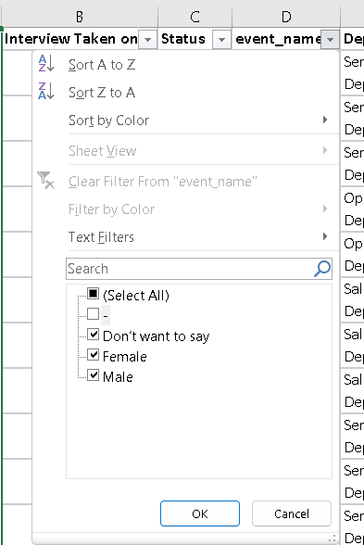
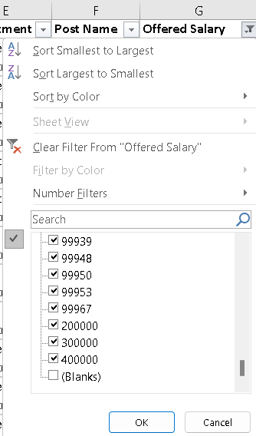
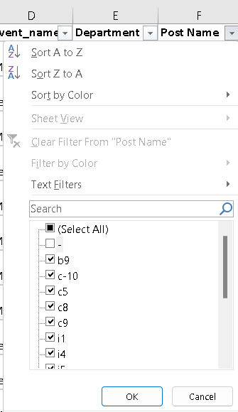
Data Cleaning & Missing Value Treatment:
We have removed those missing rows from the sheet in Excel to make the data more efficient for visualization and Insight Extraction. This process is very important when analyzing any data for a business because Missing Values & Outliers can skew our observations.
If Missing values are very large in numbers then we cant remove all those rows. In this case we replace these missing values either by MEAN, MEDIAN or any other Data That we Think fits.
In the 6th column where ‘Post Tiers’ data is available the code for each tier is a combination of one letter and a number clubbed together but one of the data category(‘c-10’) contains ‘-’ in between. To make the data look nicer we will remove the ‘-’ to give it a more efficient look.
Converted to ‘c10’

Slide 5
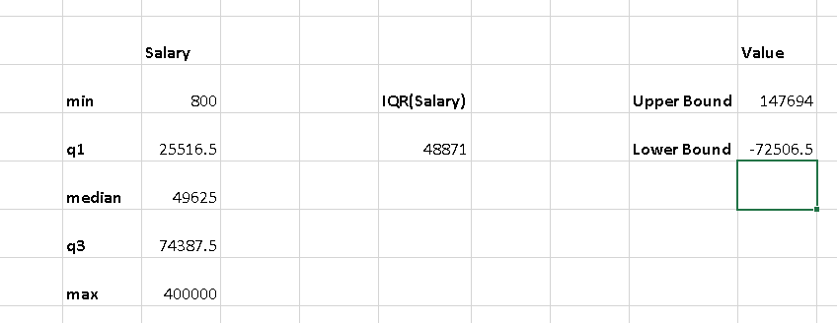
Finding Outliers and Removing Them:
An outlier is an observation that lies an abnormal distance from other values in a random sample from a population. Outliers can have a disproportionate effect on statistical results, such as the mean, which can result in misleading interpretations.
Her we have used the Quartile and IQR to find if there is an outlier in the Offered Salary column.
We calculated the ‘Upper Bound’ and ‘Lower Bound’ to get the idea about the outlier data.
We found out that there are few outliers in the data and these data has to be removed for better interpretations.
The data has been explained in the picture.
Note: In the given dataset any Offered salary above (147694) & below (-72506.5) is an outlier. We will remove these rows to get a better and clean dataset.

Slide 6
Data Description Before and After Cleaning
 | Number of rows Before Cleaning | Number of Rows after Cleaning
Application_id | 7169 | 7149
Interview Taken on | 7169 | 7149
Status | 7169 | 7149
Event_name | 7169 | 7149
Department | 7169 | 7149
Post Name | 7169 | 7149
Offered Salary | 7169 | 7149
These rows had to be removed because they were affecting the Quartile for the given data. If these data were considered they might have skewed the visualization.

Slide 7
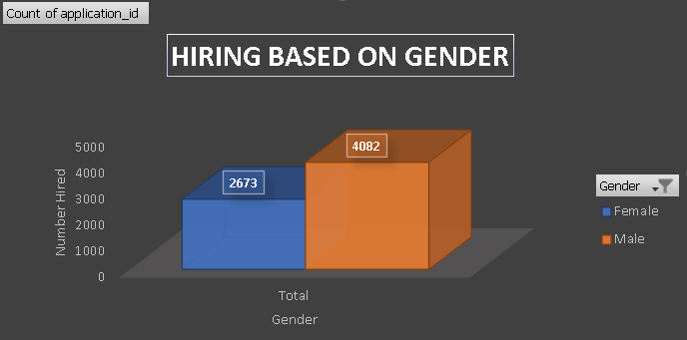
Visualization & Summary
HIRING:
Q. How Many males &Females are hired?
2673 Females and 4082 Males are hired.
It clearly shows that Males are hired almost double that of females.

Slide 8
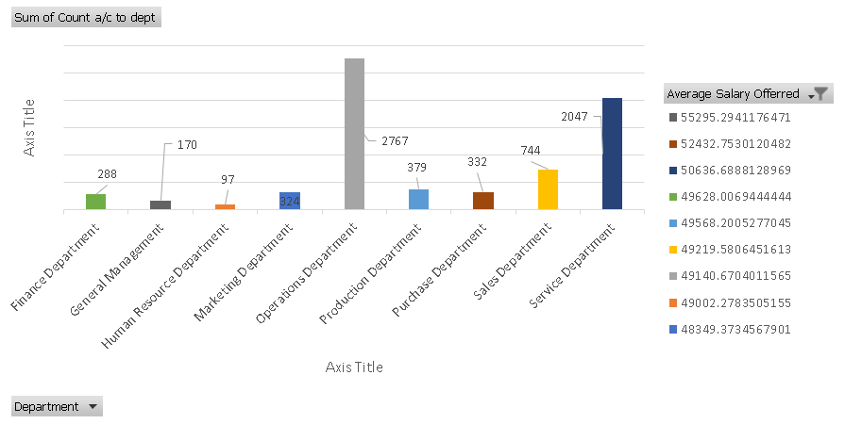
Visualization & Summary
AVERAGE SALARY:
Q. What is the average salary according to various departments?
It is clearly visible that the maximum average salary is for the HR Department followed by Purchase Department.
It clearly shows that the least average salary is for the Marketing Department.

Slide 9
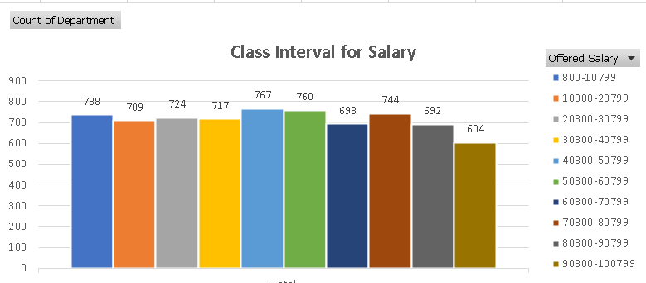
CLASS INTERVALS:
Q. Create Class Interval for Salary?
A Class Interval of 10000 has been created for Offered Salary to understand how what count of Department falls under which class.
The maximum count of department falls under the bracket of 60800-70799

Slide 10
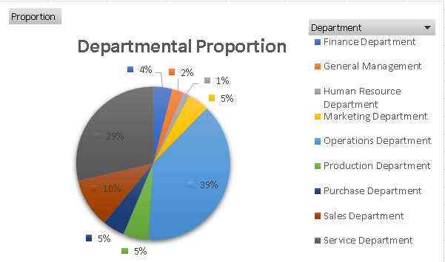
CHART & PLOTS:
Q. Draw Pie Chart / Bar Graph ( or any other graph ) to show proportion of people working different department ?
Maximum percentage of people work in the Operations Department.
Production & Purchase Department have the same parentage of people working.

Slide 11
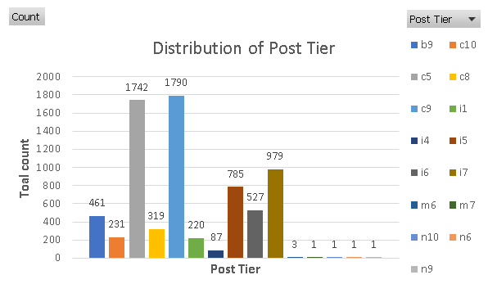
Visualization & Summary
Chart:
Q. Represent different Post Tier using Chart/Graph?
c5 & c9 have the maximum count .
M6 to n9 have only 1 candidates each.

Slide 12
Takeaway:
How to get insights about the requirement to run a business in Excel
How to create class interval.
How to use Quartiles and IQR to find outliers.
Excel visualization

